Slide 1

Project Report On
“Web Application For e-Buy Tech”
Submitted for 3rd semester project fulfillment towards the degree of
MASTER IN COMPUTER APPLICATIONS (MCA)
Submitted To
Shree Swaminarayan Institute of Technology (Affiliated to Gujarat Technological University)
December 2023
Submitted By :
Name
Enrollment No
Koladiya Jaimin
225330694028
Kotadiya Jaykrut
225330694029
Nakrani Meet
225330694038

Slide 2
INDEX
No. | Content | Page No
1 | Project Profile | 1
2 | Work Distribution among group members | 2
3 | Goals And Objectives | 3
4 | Problem Area & Project Definition | 4-5
5 | System Analysis | 6
6 | Module Hierarchy | 7
7 | UML-Diagrams :
 | 7.1 Use-Case Diagram | 8
 | 7.2 Class Diagram | 9
 | 7.3 Activity Diagram | 10-11
 | 7.4 Sequence Diagram | 12-17
No. | Content | Page No
8 | Software Design :
 | 8.1 Data Dictionary | 18-24
9 | GUI Design :
 | 9.1 Screen Layouts | 25-36
10 | About the tools & Technologies
 | 10.1 Tools | 37
 | 10.2 Technologies | 37
11 | Bibliography | 38

Slide 3
1. Project Profile
Project Title | Web application for e-Buy Tech
Front-End | React js
Back-End | Laravel
Database | MYSQL 8
Project team size | 3
Submitted By | 1. Koladiya Jaimin (225330694028)
 | 2. Kotadiya Jaykrut (225330694029)
 | 3. Nakrani Meet (225330694038)
1
SSIT MCA Semester-III Project (2023)

Slide 4
2. Work Distribution among group members
Let’s me to clarify that there are three member in our group Koladiya Jaimin , Kotadiya Jaykrut and Nakrani Meet. we work together in this project.
2
SSIT MCA Semester-III Project (2023)

Slide 5
3.Goals And Objectives
Admin can manage order efficiently.
Admin can manage product easily.
Customer can buy product easily.
3
SSIT MCA Semester-III Project (2023)

Slide 6
4. Problem Area & Project Definition
Problem Area :-
Customer need to wait for product.
Admin have more responsibility.
4
SSIT MCA Semester-III Project (2023)

Slide 7
4. Problem Area & Project Definition
Project Definition:-
e-Buy Tech is an innovative e-commerce web application designed to provide users with a seamless and secure platform for purchasing a variety of tech products, including mobile phones, chargers, laptops, earbuds, and more. The application aims to streamline the online shopping experience for tech enthusiasts, offering a diverse range of products from various brands.
5
SSIT MCA Semester-III Project (2023)

Slide 8
5. System Analysis
Input :-
The major inputs of the system are:
Admin can add new product.
Admin can add new product category.
Customer can place order.
Output :-
Various outputs are generated, once all the required inputs are provided to the application.
The major outputs of the system are:
Admin can see all the order.
Customer can see all the product.
6
SSIT MCA Semester-III Project (2023)

Slide 9
6. Project Module
1. Admin Module :-
Manage Category
Manage Product
Manage Customer
Manage Order
Manage Payment
Manage Feedback
2. Customer Module :-
View Category
View Product
View Profile
Add to Cart
Place Order
Give Feedback
3. Visitor Module :-
Registration
View Product
7
SSIT MCA Semester-III Project (2023)

Slide 10
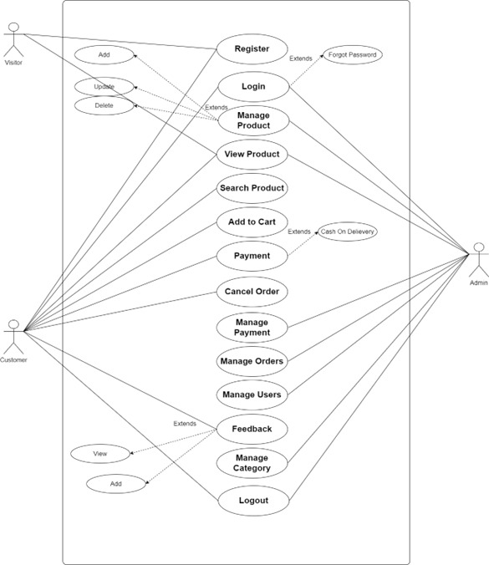
7. UML-Diagrams
7.1 Use-Case Diagram
8
SSIT MCA Semester-III Project (2023)

Slide 11
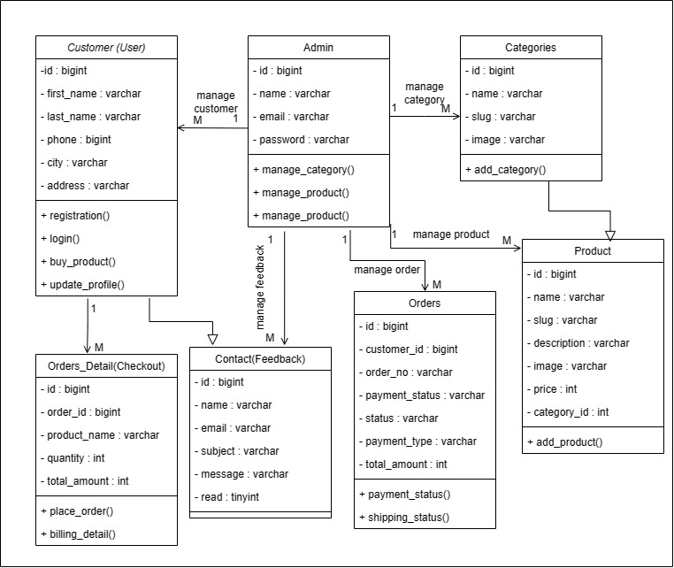
7. UML-Diagrams
7.2 Class Diagram
9
SSIT MCA Semester-III Project (2023)

Slide 12
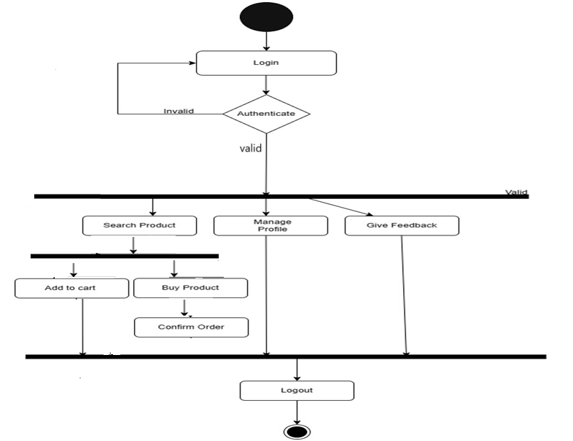
7. UML-Diagrams
7.3 Activity Diagram
User Activity diagram
10
SSIT MCA Semester-III Project (2023)

Slide 13
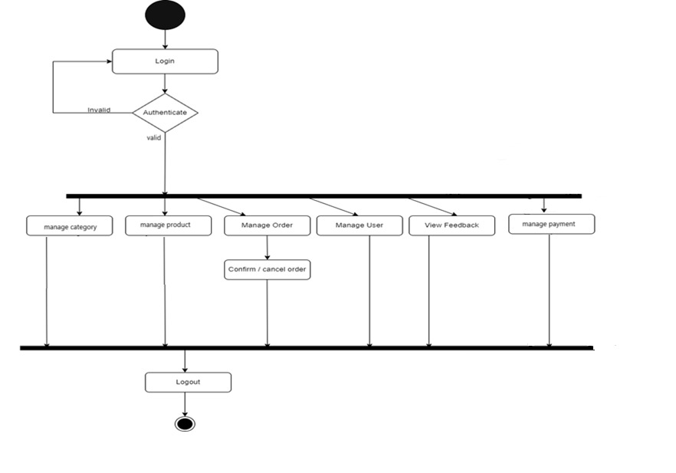
7. UML-Diagrams
7.3 Activity Diagram
Admin Activity diagram
11
SSIT MCA Semester-III Project (2023)

Slide 14
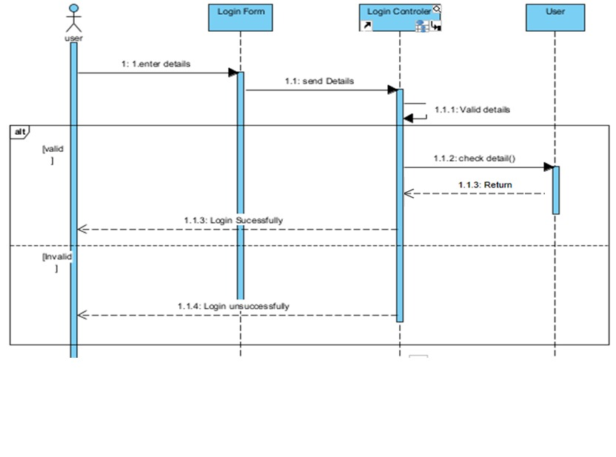
7. UML-Diagrams
7.4 Sequence Diagram
Login Sequence diagram
12
SSIT MCA Semester-III Project (2023)

Slide 15
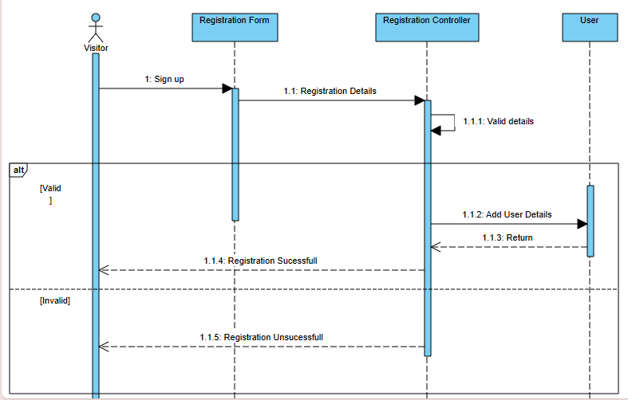
7. UML-Diagrams
7.4 Sequence Diagram
Registration Sequence diagram
13
SSIT MCA Semester-III Project (2023)

Slide 16
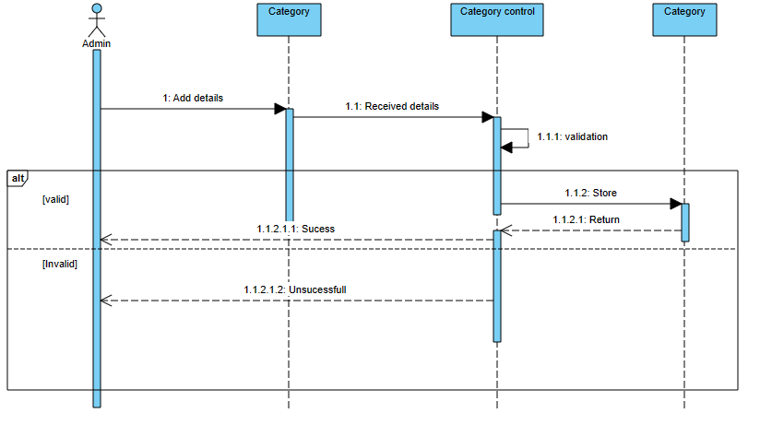
7. UML-Diagrams
7.4 Sequence Diagram
Add Category Sequence diagram
14
SSIT MCA Semester-III Project (2023)

Slide 17
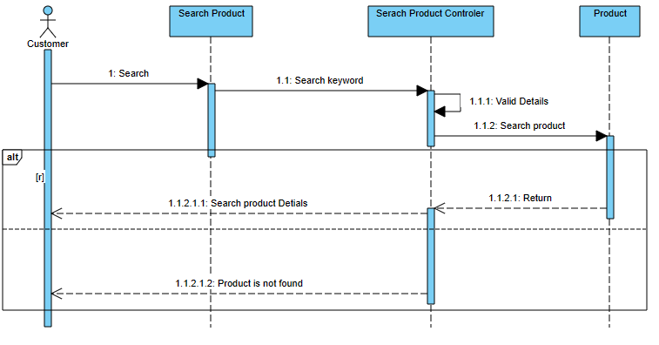
7. UML-Diagrams
7.4 Sequence Diagram
Search Product Sequence diagram
15
SSIT MCA Semester-III Project (2023)

Slide 18
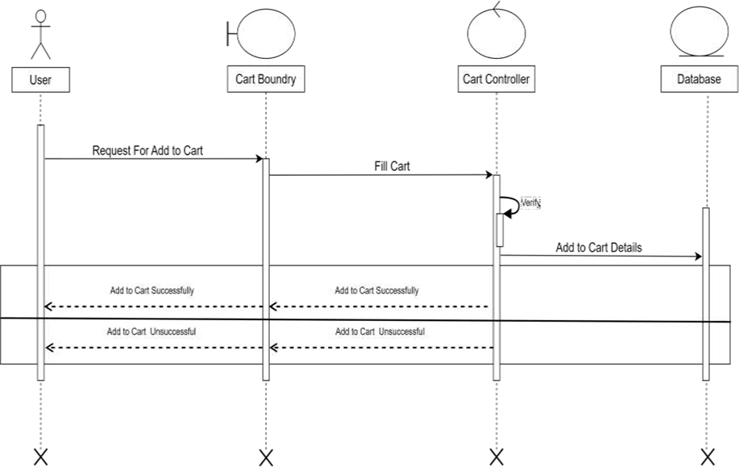
7. UML-Diagrams
7.4 Sequence Diagram
Add To Cart Sequence diagram
16
SSIT MCA Semester-III Project (2023)

Slide 19
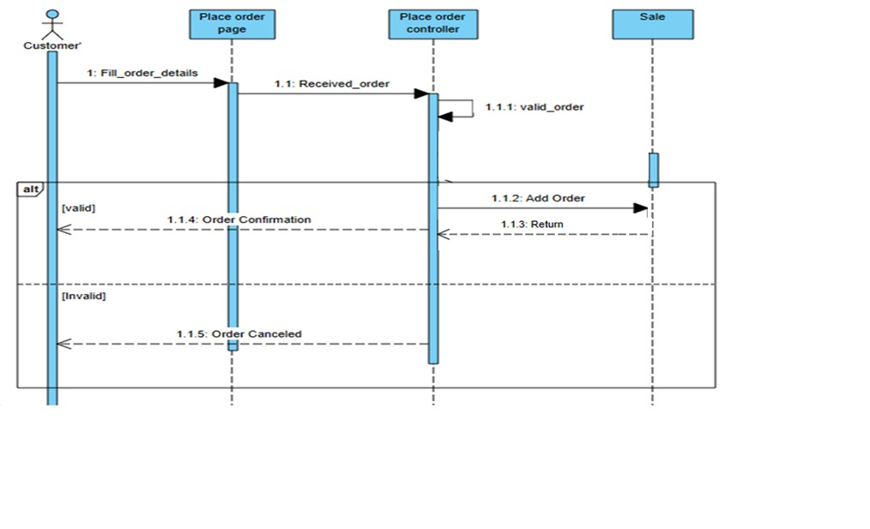
7. UML-Diagrams
7.4 Sequence Diagram
Place Order Sequence diagram
17
SSIT MCA Semester-III Project (2023)

Slide 20
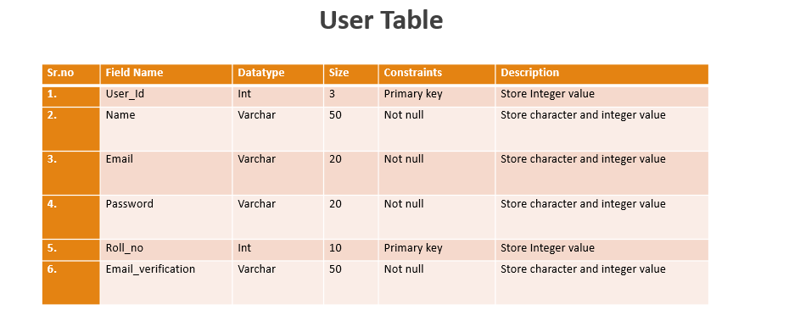
8. Software Design
8.1 Data Dictionary
Table Name: User
Description: This table contains all the details of user
18
SSIT MCA Semester-III Project (2023)

Slide 21
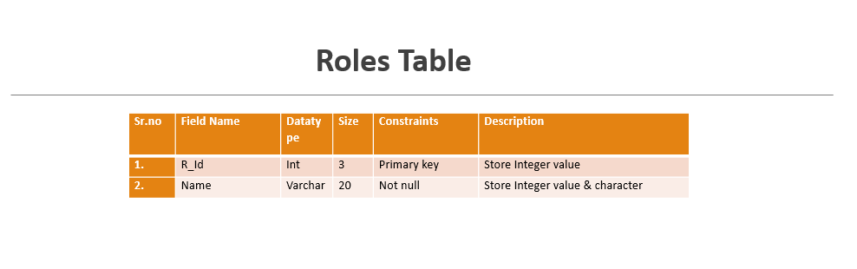
8. Software Design
8.1 Data Dictionary
Table Name: Roles
Description: This table contains all the details of Role.
19
SSIT MCA Semester-III Project (2023)

Slide 22
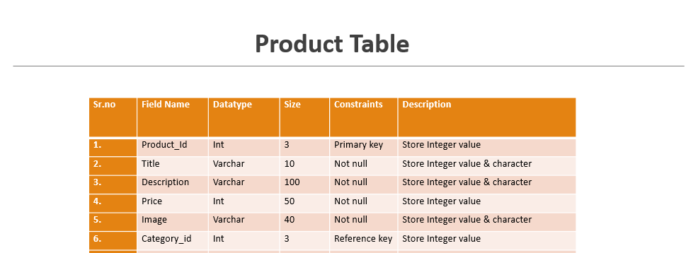
8. Software Design
8.1 Data Dictionary
Table Name:Product
Description: This table contains all the details of Product.
20
SSIT MCA Semester-III Project (2023)

Slide 23
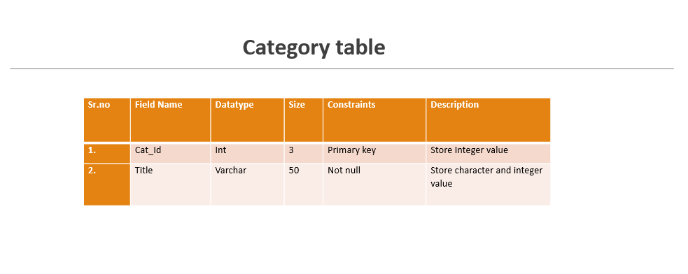
8. Software Design
8.1 Data Dictionary
Table Name: Category
Description: This table contains all the details of Category.
21
SSIT MCA Semester-III Project (2023)

Slide 24
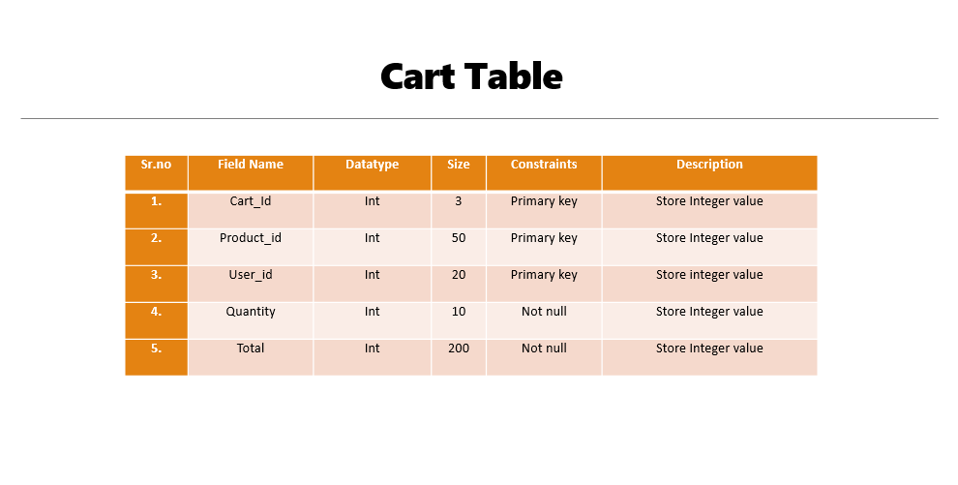
8. Software Design
8.1 Data Dictionary
Table Name: Cart
Description: This table contains all the details of Cart.
22
SSIT MCA Semester-III Project (2023)

Slide 25
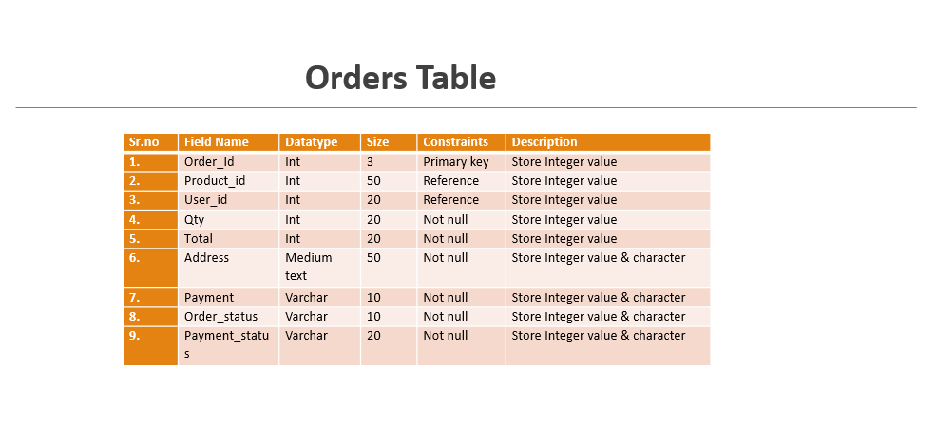
8. Software Design
8.1 Data Dictionary
Table Name: Order
Description: This table contains all the details of Order.
23
SSIT MCA Semester-III Project (2023)

Slide 26
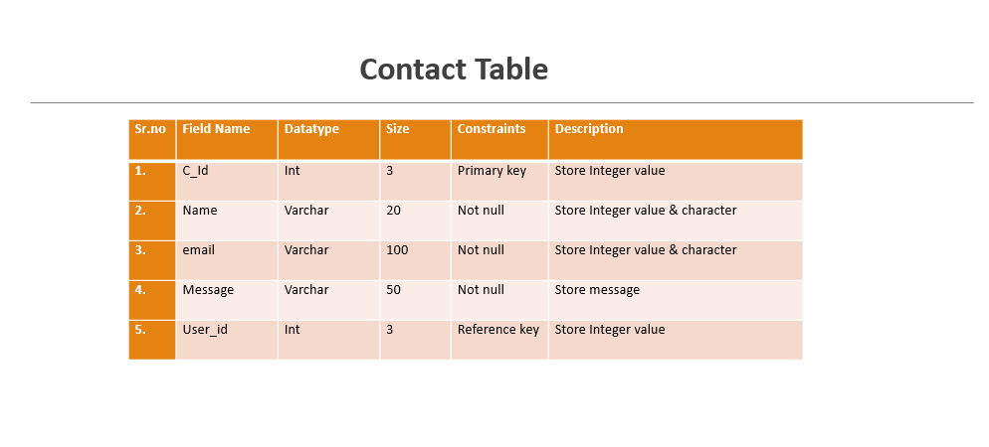
8. Software Design
8.1 Data Dictionary
Table Name: Contact
Description: This table contains all the details of Contact.
24
SSIT MCA Semester-III Project (2023)

Slide 27
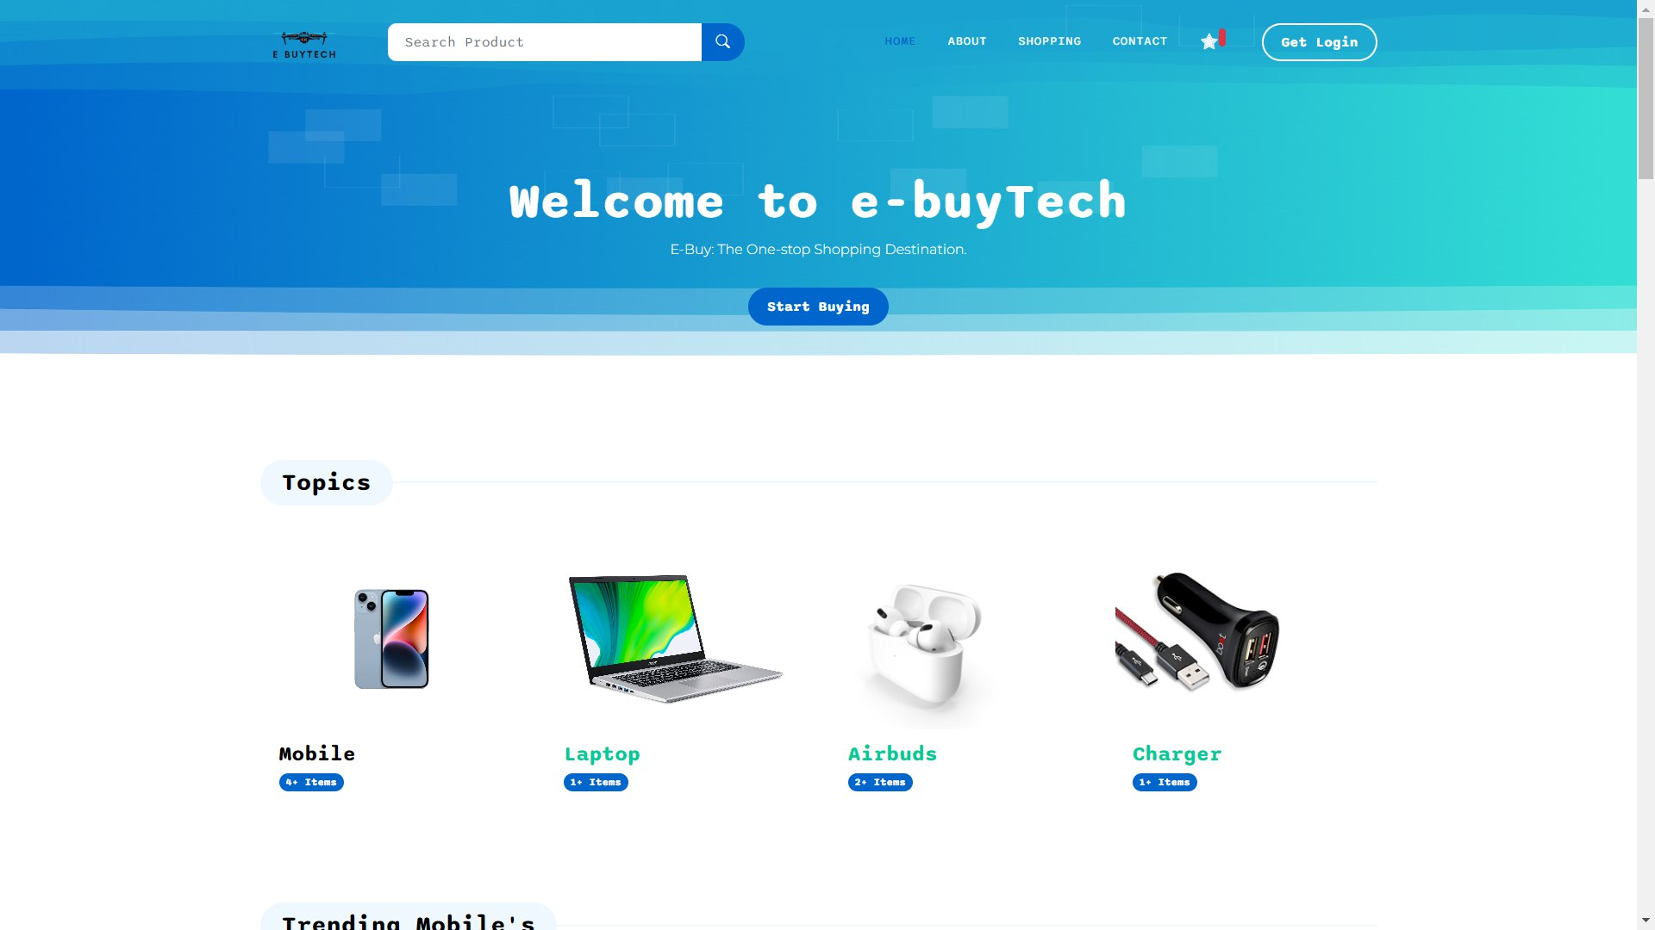
9. GUI Design
9.1 Screen Layout
Website Layout
25
SSIT MCA Semester-III Project (2023)

Slide 28
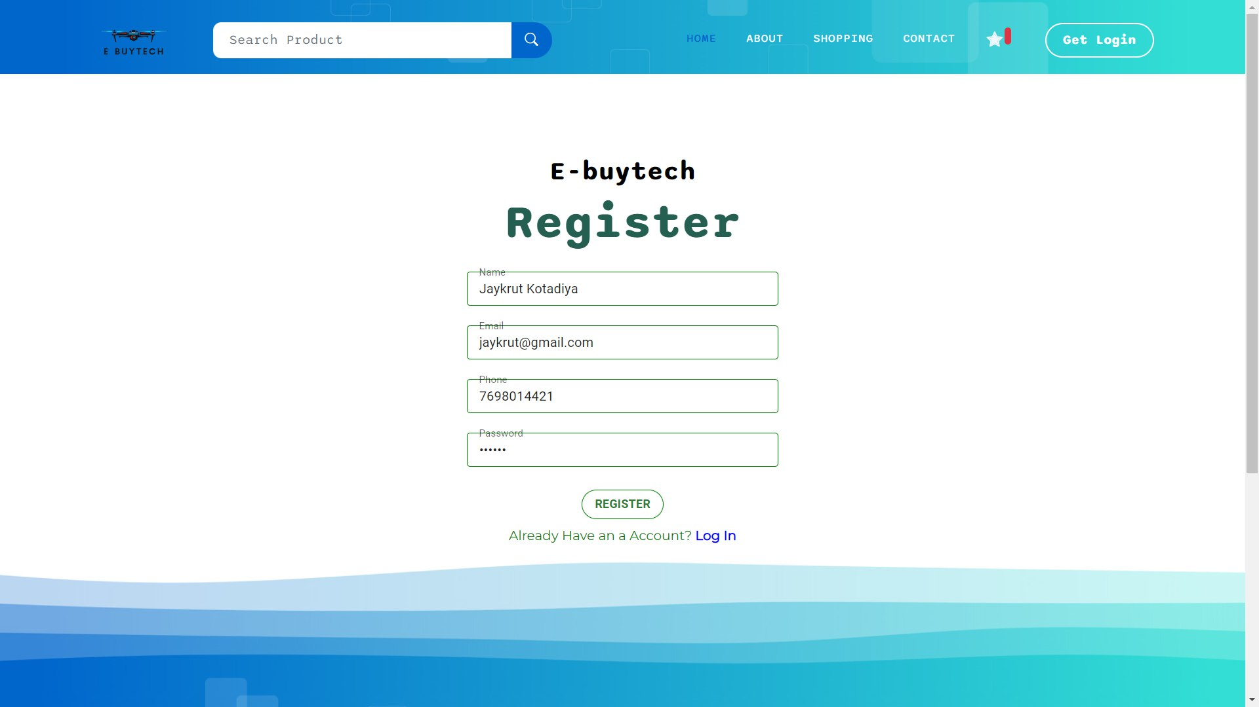
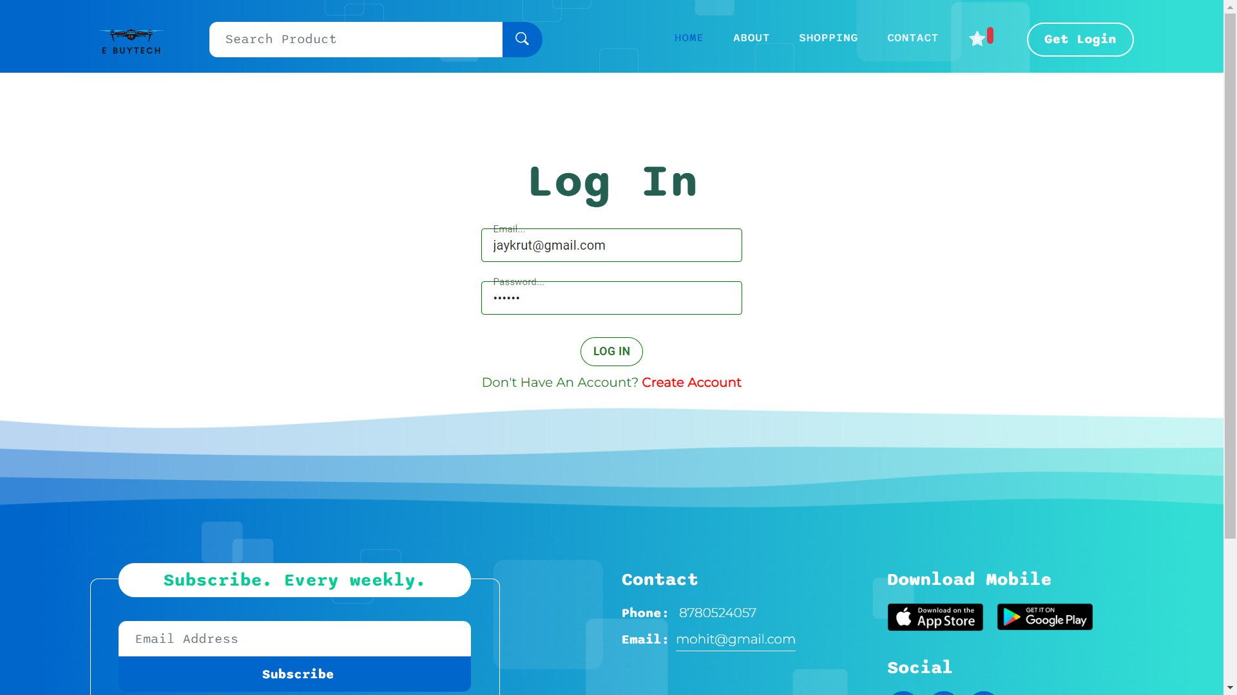
9. GUI Design
9.1 Screen Layout
Customer- Login/Register
26
SSIT MCA Semester-III Project (2023)

Slide 29
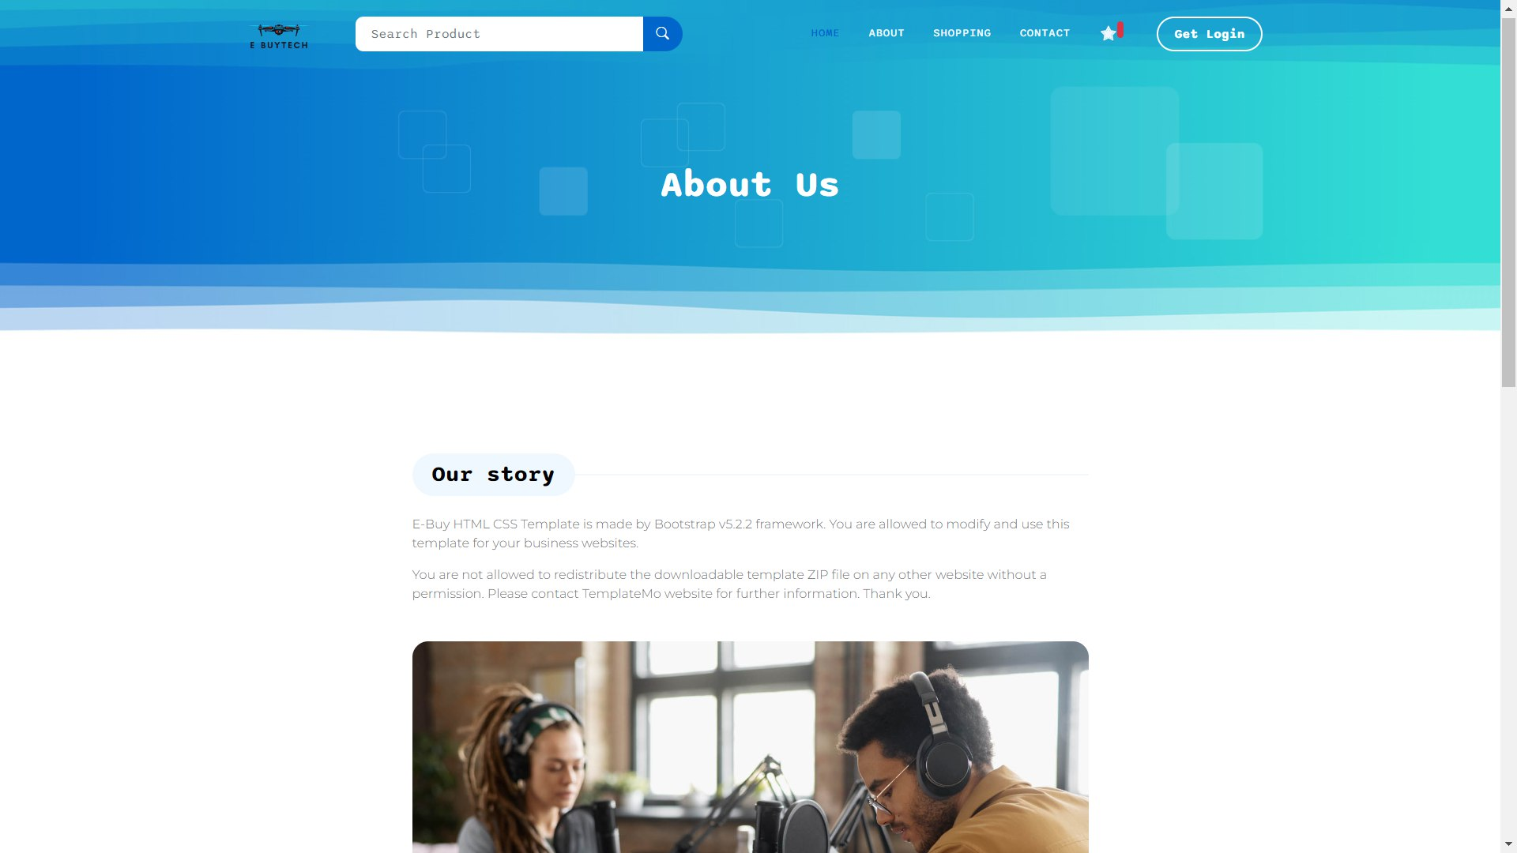
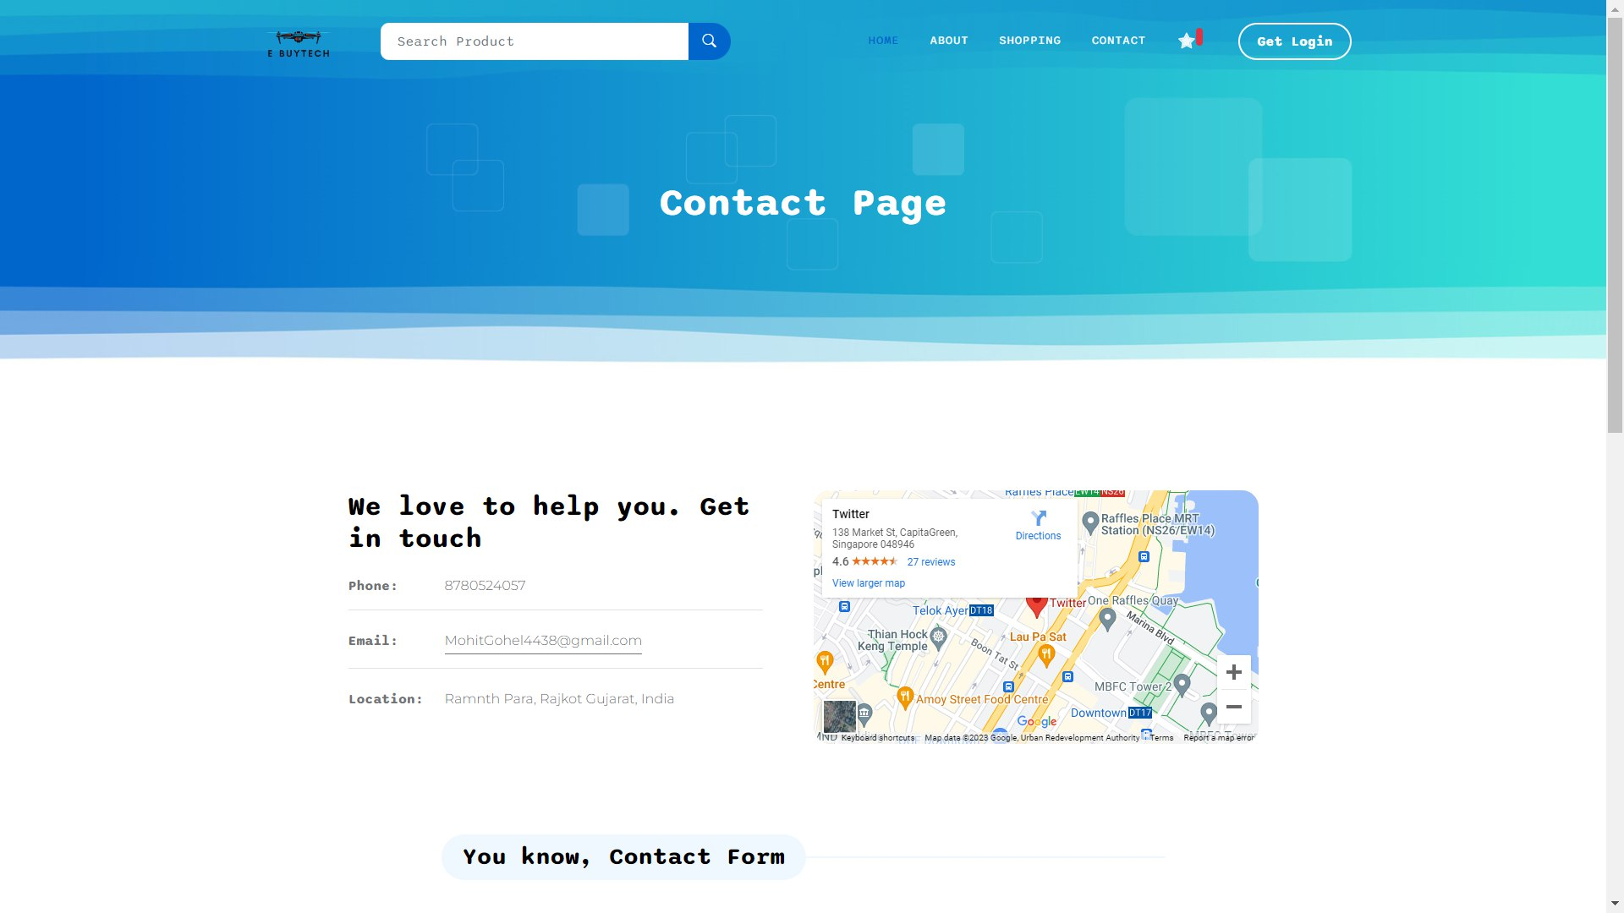
9. GUI Design
9.1 Screen Layout
Customer-About us/ Contact page
27
SSIT MCA Semester-III Project (2023)

Slide 30
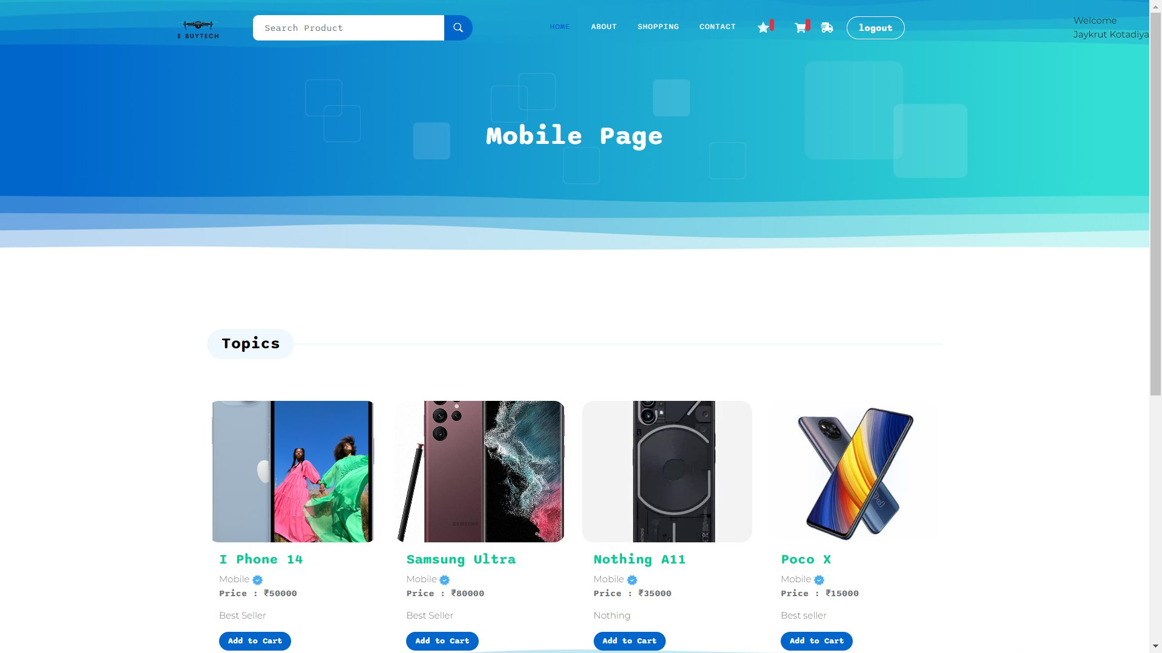
9. GUI Design
9.1 Screen Layout
Customer- Product Page
28
SSIT MCA Semester-III Project (2023)

Slide 31
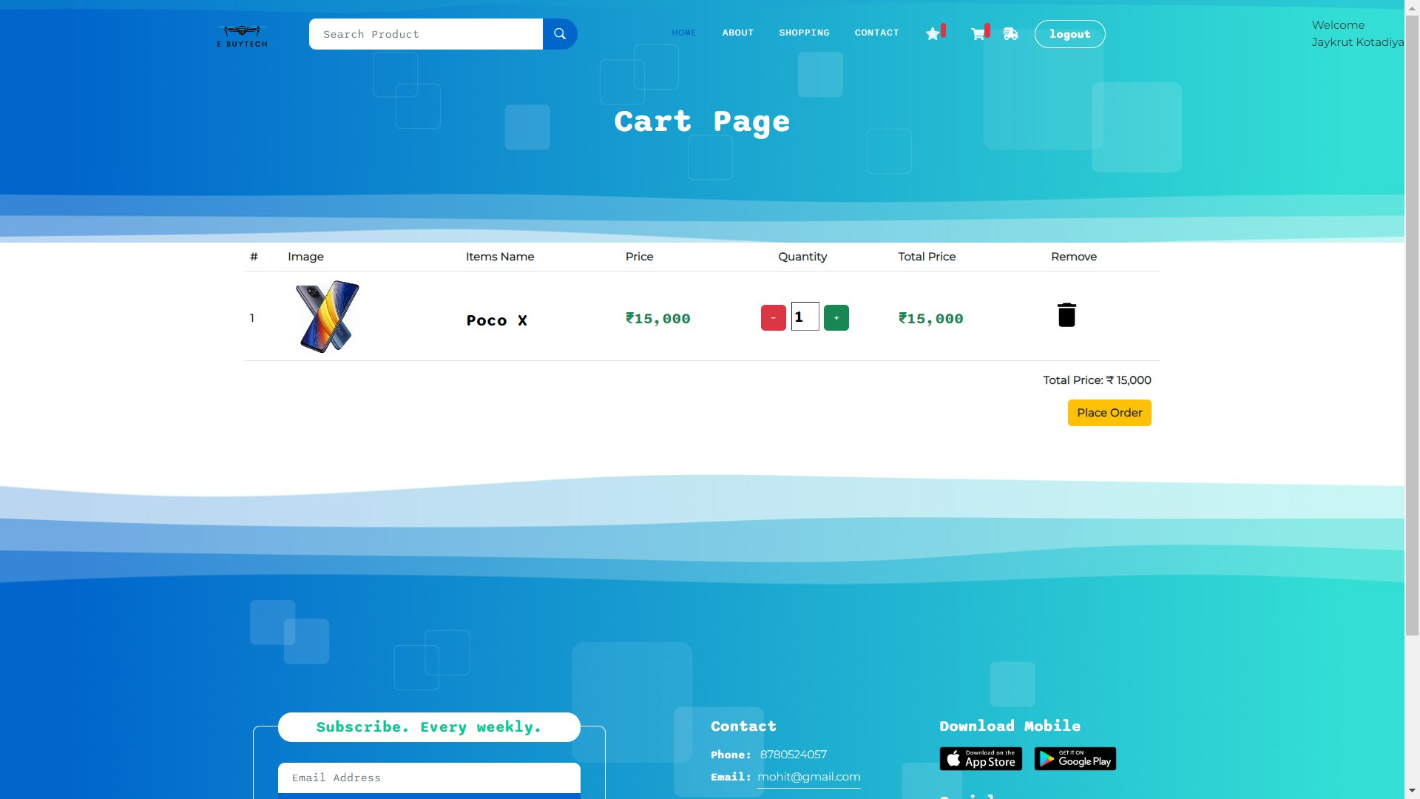
9. GUI Design
9.1 Screen Layout
Customer - Cart
29
SSIT MCA Semester-III Project (2023)

Slide 32
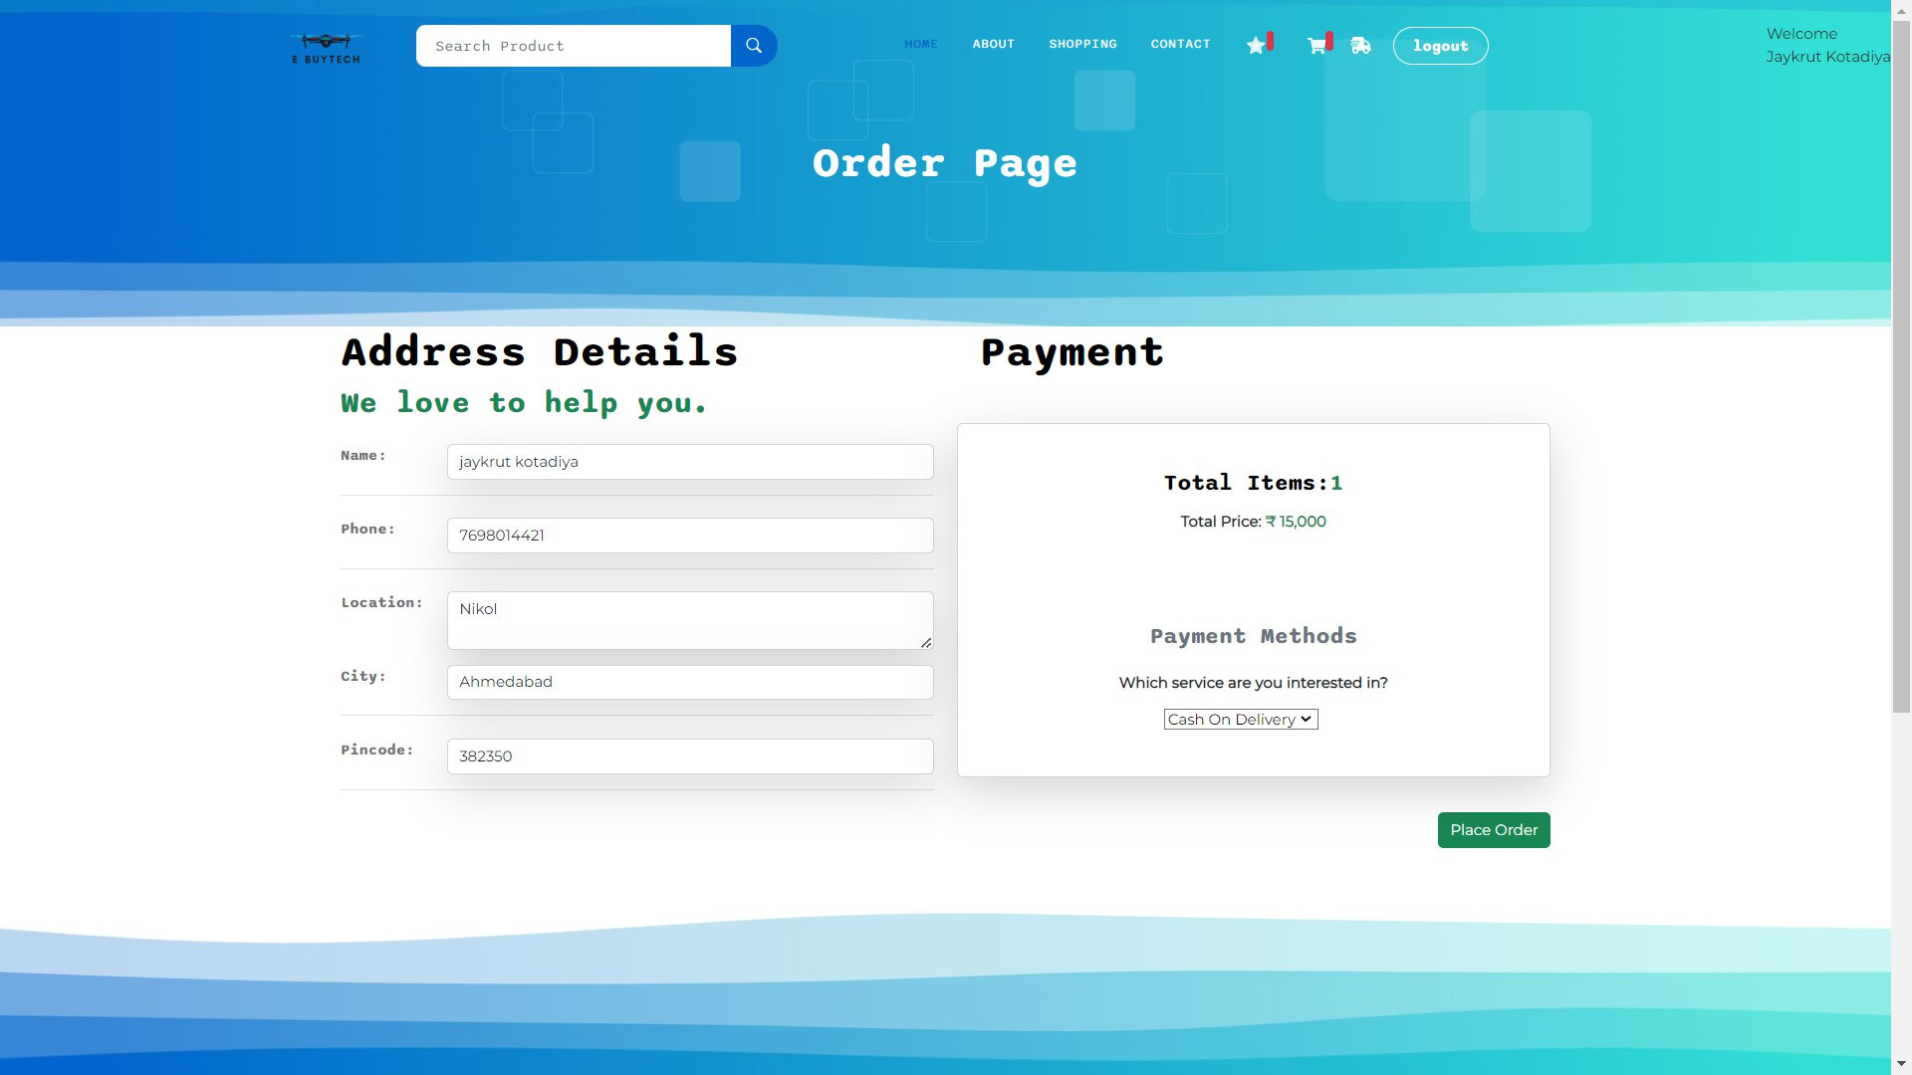
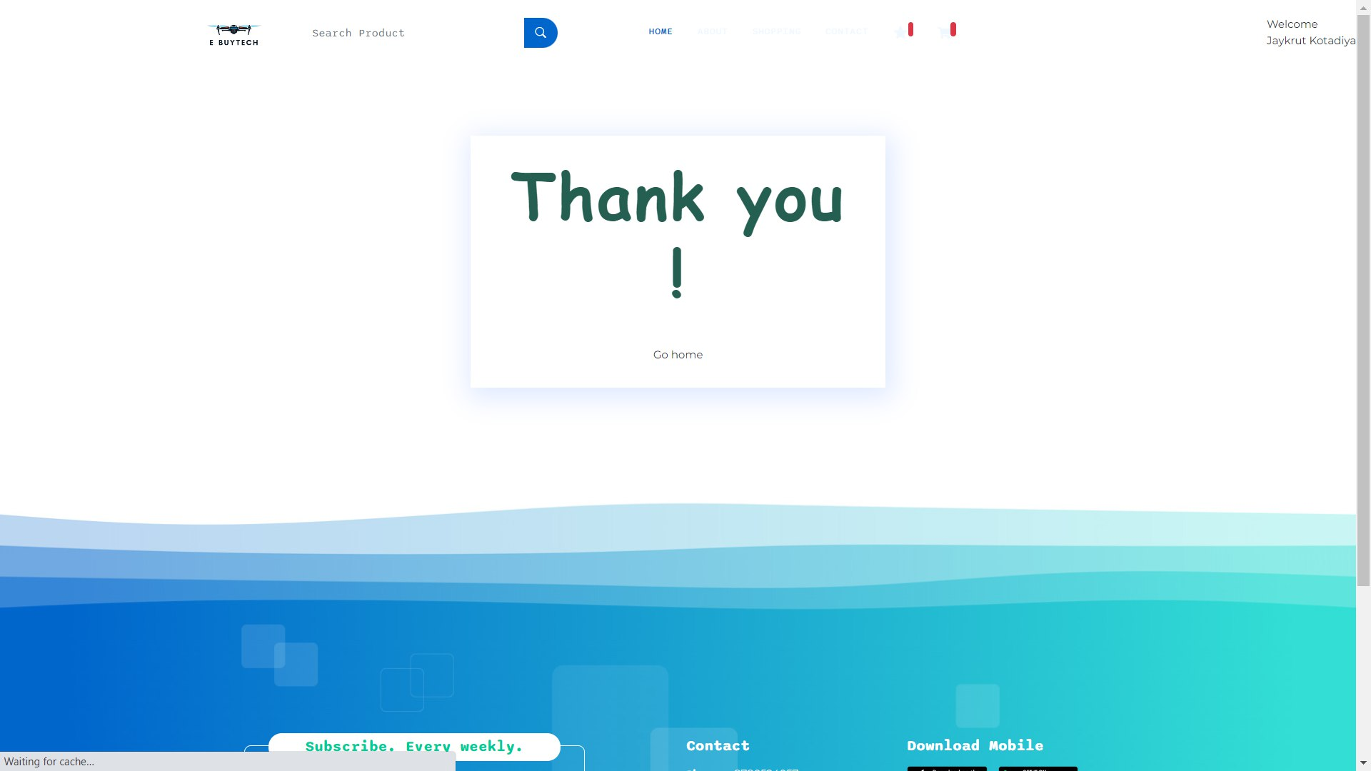
9. GUI Design
9.1 Screen Layout
Customer – Order Deatils
30
SSIT MCA Semester-III Project (2023)

Slide 33
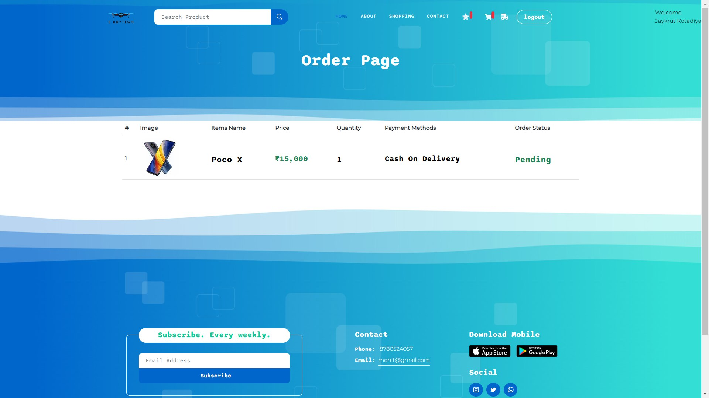
9. GUI Design
9.1 Screen Layout
Customer- Order
31
SSIT MCA Semester-III Project (2023)

Slide 34
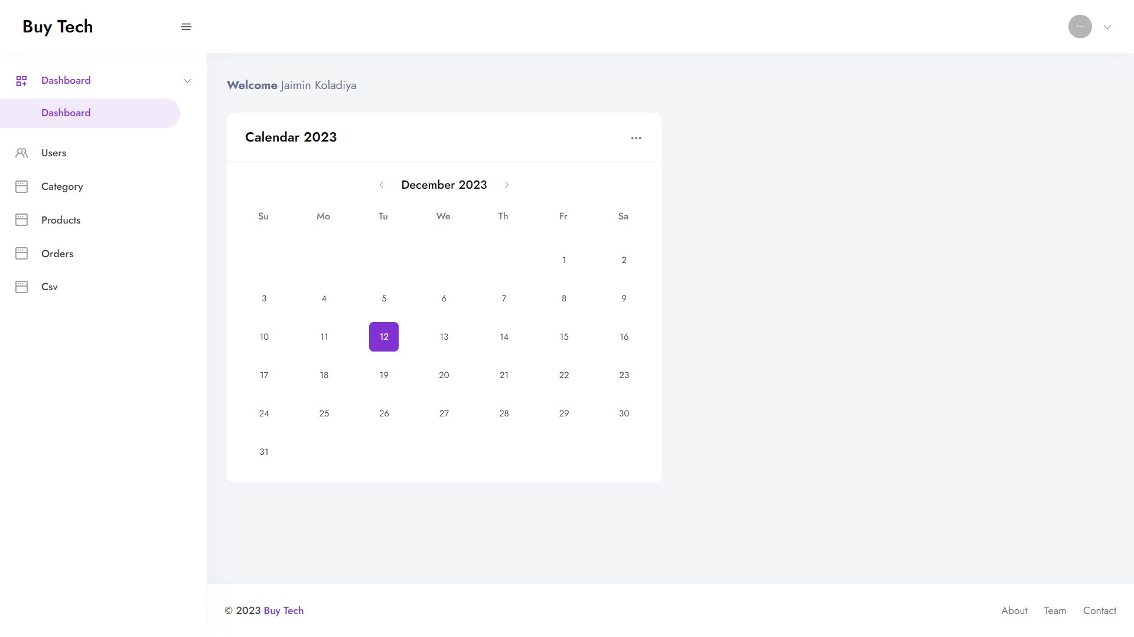
9. GUI Design
9.1 Screen Layout
Admin - Dashboard
32
SSIT MCA Semester-III Project (2023)

Slide 35
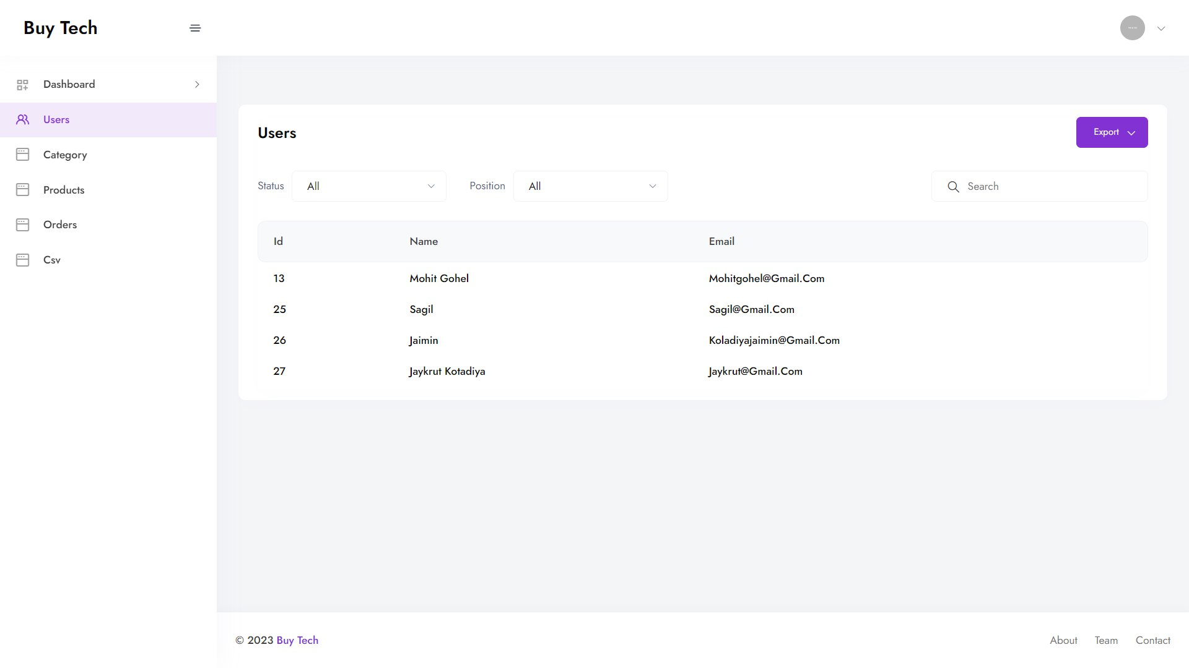
9. GUI Design
9.1 Screen Layout
Admin – All User
33
SSIT MCA Semester-III Project (2023)

Slide 36
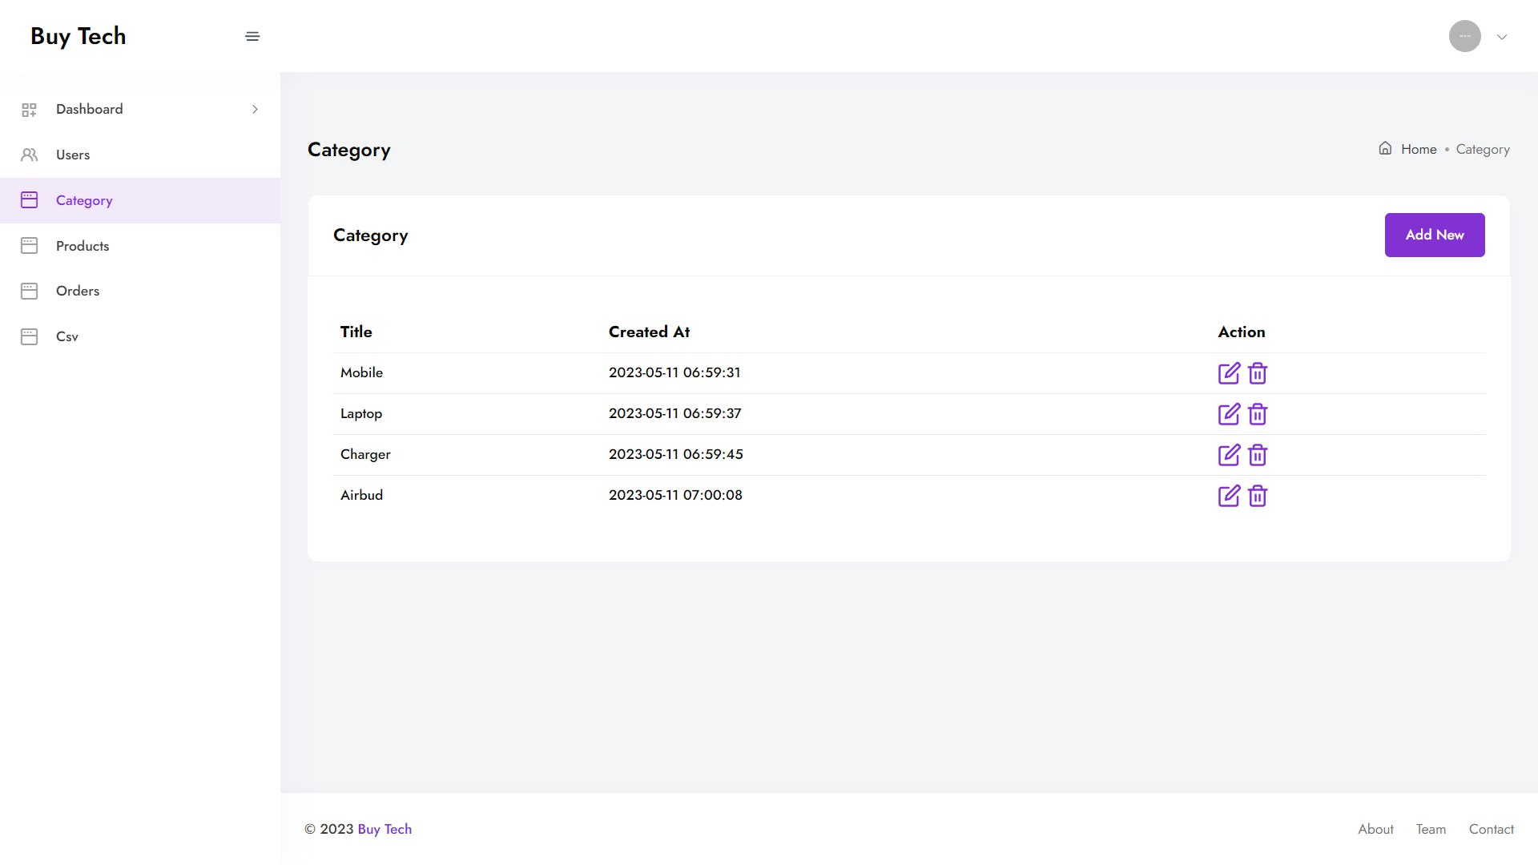
9. GUI Design
9.1 Screen Layout
Admin – Product Category
34
SSIT MCA Semester-III Project (2023)

Slide 37
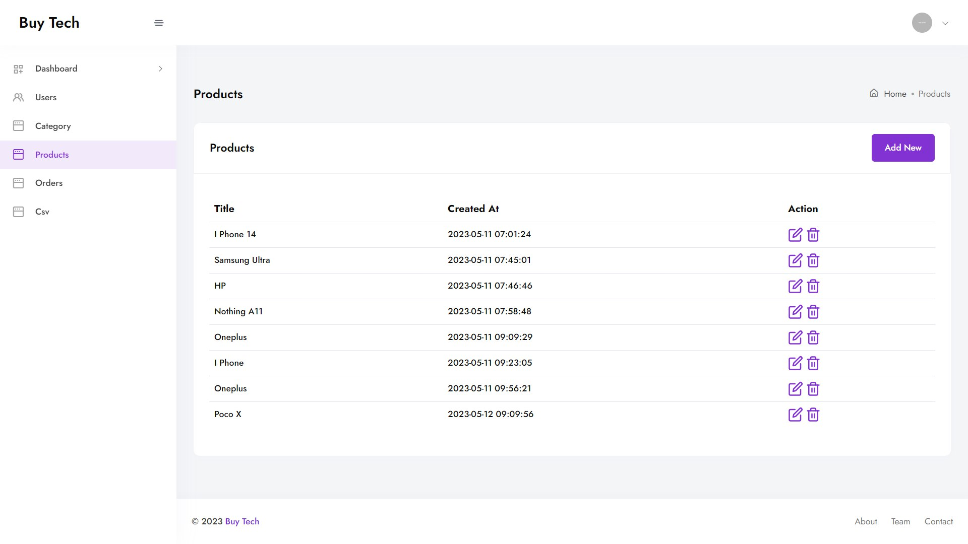
9. GUI Design
9.1 Screen Layout
Admin - All Product
35
SSIT MCA Semester-III Project (2023)

Slide 38
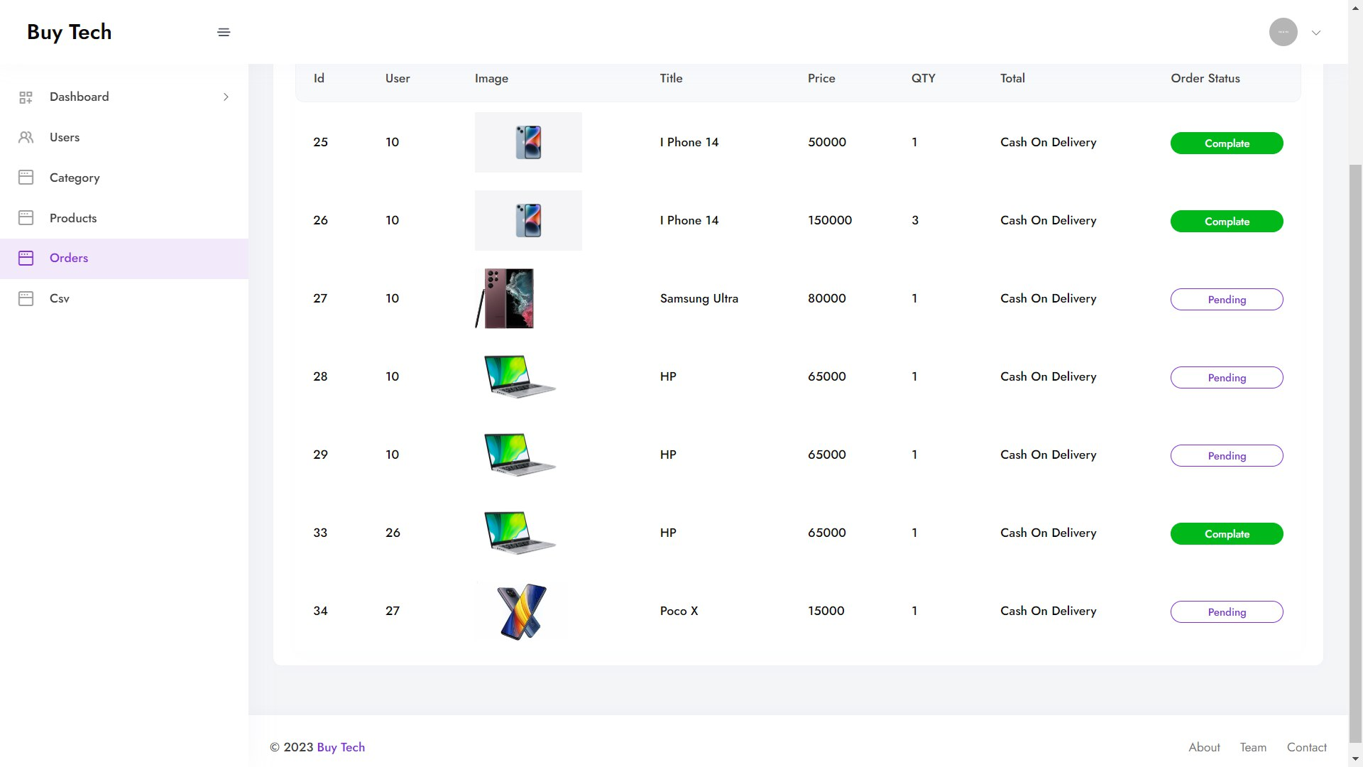
9. GUI Design
9.1 Screen Layout
Admin - All Order
36
SSIT MCA Semester-III Project (2023)

Slide 39
10. About tools & technologies
10.1 Tools :-
Editor : Visual Studio Code
UML Diagram Tool : Visual paradigm 8
ER Diagram Tool : MYSQL Workbench 5
10.2 Technologies :-
Front-End Languages :React Js
Back-End Language : LARAVEL 8
Database : MySQL 8
Server : Apache 2
37
SSIT MCA Semester-III Project (2023)

Slide 40
11. Bibliography
Websites:-
https://laravel.com/
https://www.w3schools.com/react/
https://legacy.reactjs.org/docs/getting-started.html
38
SSIT MCA Semester-III Project (2023)

Slide 41
THANK YOU!
39
SSIT MCA Semester-III Project (2023)

